Slide 1
Connections Outcomes Framework (COF)
OPEN Symposium Presentation
Date: Oct 30 2017
Presenter: Kathryn Mackay, Senior Project Leader
E: kathryn.mackay@connections.org.au
T: (03) 8792 8999

Slide 2
Connections Outcomes Framework – highlights, learnings and data 2 years in.

Slide 3
Overview
The Connections Outcomes Framework (COF) was introduced to address the funding shift from measuring inputs/outputs to individual outcomes – the difference we have made.

Slide 4
The COF has now been implemented across approximately 30 programs with over 2000 clients, including 2 programs where it is being used with external agencies as part of an alliance.
Roll-out will be completed by the end of 2017 – implementation with our final 2 programs is underway.

Slide 5
The COF Model:
Developed through an extensive research and consultation phase commencing November 2014
Structure consists of five elements operating in a pyramid format, enabling individual client results to be aggregated to a program, division and agency level :

Slide 6
Strategic Objective
Domains
Outcomes
Indicators
Measures
the change we wish to achieve overall
the key domains in which change is desired
the life areas where we support clients to achieve change
how we know progress is being made
how we measure progress
Note: The 3 lower tiers are the operational part of the framework and the key elements in terms of case practice

Slide 7
Strategic Objective:
Comes directly from the Connections Strategic Plan:
‘Making Lives Better’
(note: this will change given the shift to Uniting)

Slide 8
Domains:
Reflect the key areas in which we seek to make lives better:
Live – the person / family
Connect – their place in community / society
Grow – their aspirations

Slide 9
Outcome Areas:
21 outcome areas (each aligned to a higher level domain), used varyingly by the programs
Outcome areas are applicable to Parent/Caregivers, Young Persons and/or Children, enabling individualised outcomes measurement for multiple family members

Slide 10
Outcome Area | Parent/Caregiver | Young Person | Child
Life and Coping Skills | ✓ | ✓
Education and Ambitions | ✓ | ✓
Community Connectedness | ✓ | ✓
Family Communications / Relations | ✓ | ✓
Family Violence | ✓ | ✓
Alcohol and Other Drugs | ✓ | ✓
Housing | ✓ | ✓
Income, Finances and Employment | ✓ | ✓
Cultural Connectedness | ✓ | ✓ | ✓
Physical Health | ✓ | ✓ | ✓
Emotional and Mental Health | ✓ | ✓ | ✓
Relationship / Attachment with Parent/Caregiver |  | ✓ | ✓
Safety |  | ✓ | ✓
Basic Needs |  | ✓ | ✓
Behaviour and Social Skills |  | ✓ | ✓
Stability/Permanency |  | ✓ | ✓
Education and Learning Participation |  | ✓ | ✓
Development |  |  | ✓
Insight and Emotional Stability (OOHC) |  | ✓ | ✓
Relationship with Birth Family (A&PC) |  | ✓ | ✓
Community Risk | ✓ | ✓
Note: Not applicable (n/a) can be used for any outcome areas that are not (or not yet) applicable or known for a client

Slide 11
Indicators and Measures
Attached to each Outcome Area to form the basis of the assessment process
Practitioners use an assessment tool to identify where clients are at in each of the outcome areas

Slide 12
The tool uses a measurement scale of five status levels, each with a corresponding numerical value, allowing results to be quantified and aggregated:
1: In Crisis / Critical
2: At Risk / Vulnerable
3: Emerging / Settling
4: Safe / Self-Sufficient
5: Thriving

Slide 13
Indicators for each status level (for each Outcome Area) provide a reliable way of identifying where the client is at – example for Housing:
Outcome Category | Thriving | Safe / Self Sufficient | Emerging / Settling | At Risk or Vulnerable | In-Crisis / Critical
Housing | Is in and has a history of being able to maintain secure housing Housing is safe Housing is well sized for the family’s needs Neighbourhood rarely experiences crime, conflicts and/or disturbances | Is established in secure housing Housing is safe Housing is adequately sized for the family’s needs Neighbourhood crime, conflicts and/or disturbances are low | Has recently obtained housing that is likely to be secure Housing may have some safety or maintenance issues that are being addressed Housing is adequately sized for the family’s needs Neighbourhood sometimes experiences crime, conflicts and/or disturbances | Housing is insecure Housing has outstanding safety or maintenance issues Housing size does not meet family’s needs Neighbourhood often experiences crime, conflicts and/or disturbances | Homeless or on the verge of homelessness Living in overcrowded and/or dangerous conditions Neighbourhood constantly experiences crime, conflicts and/or disturbances

Slide 14
Example of Matrix Outcomes Model Assessment Tool
OUTCOME AREAS | Thriving (5) | Safe / Self Sufficient (4) | Emerging / Settling (3) | At Risk or Vulnerable (2) | In-Crisis / Critical (1)
Parent / Caregiver
Physical & Emotional Health
Life & Coping Skills
Education & Ambitions
Community Connectedness
Child Specific
Relationship with Parent / Caregiver
Safety & Basic Needs
Attachment to Parent / Caregiver
Development & General Health
Education & Learning Functioning
(Note: the numerical value enables the change to be quantified and aggregated)

Slide 15
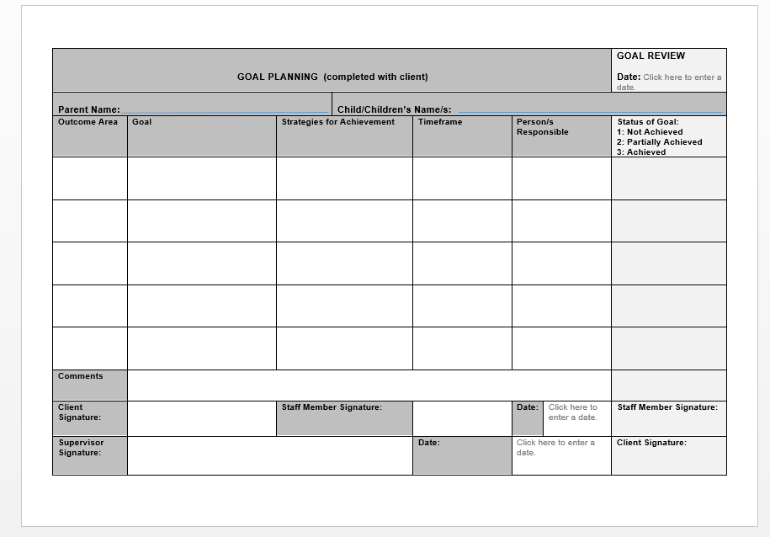
The outcomes assessment informs goal planning, with goals linked to specific Outcome Areas
– example of tool below:

Slide 16
A cycle of outcomes assessment, goal planning, service delivery and goal review continues until the case is closed – with a final outcomes assessment completed at closure.
Initial Outcomes assessment
Service Delivery
Goal Review
Subsequent Outcomes Assessment
(measure of change)
Outcomes Data
(reports)
Goal Planning

Slide 17
Data Collection and Reporting – The COF System
A custom system was developed internally to collect and report on the outcomes data
Reports can be generated for multiple levels e.g. client, staff, program, division, organisation, with a range of filters e.g. outcome area, age, gender, lga, cultural background
Note: Qualitative information is used to support and further explain the quantitative data from the COF System. This is particularly important with aggregated results.

Slide 18
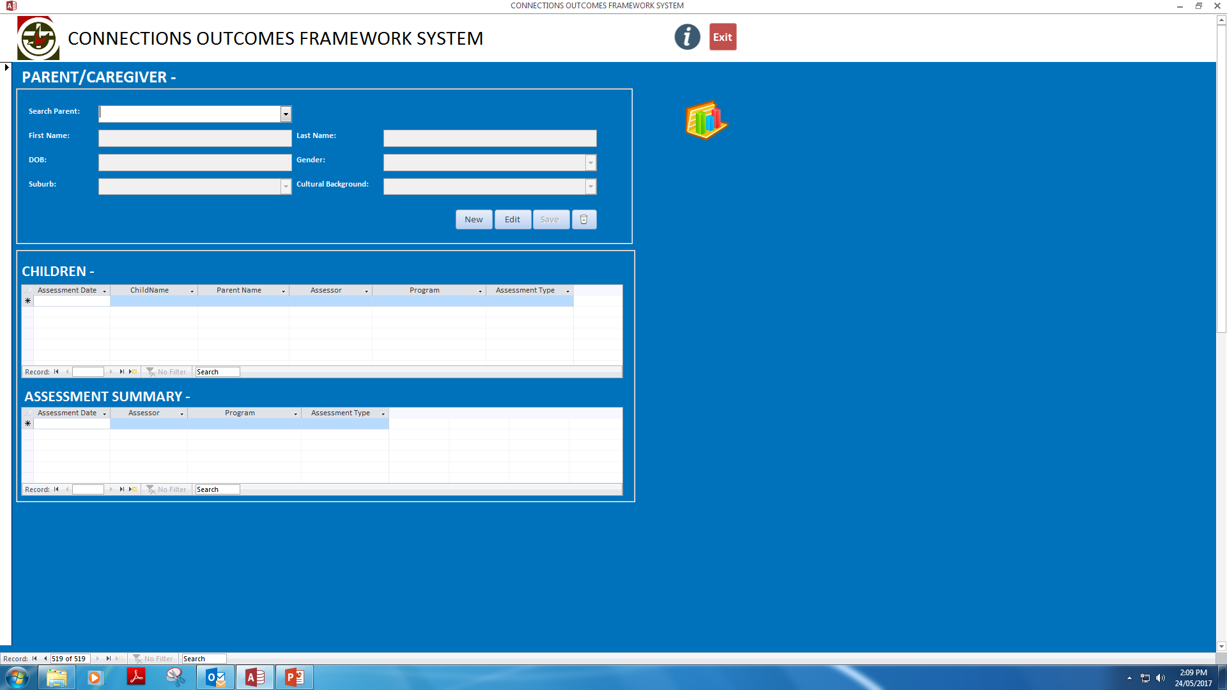
Example of COF System – Main Screen

Slide 19
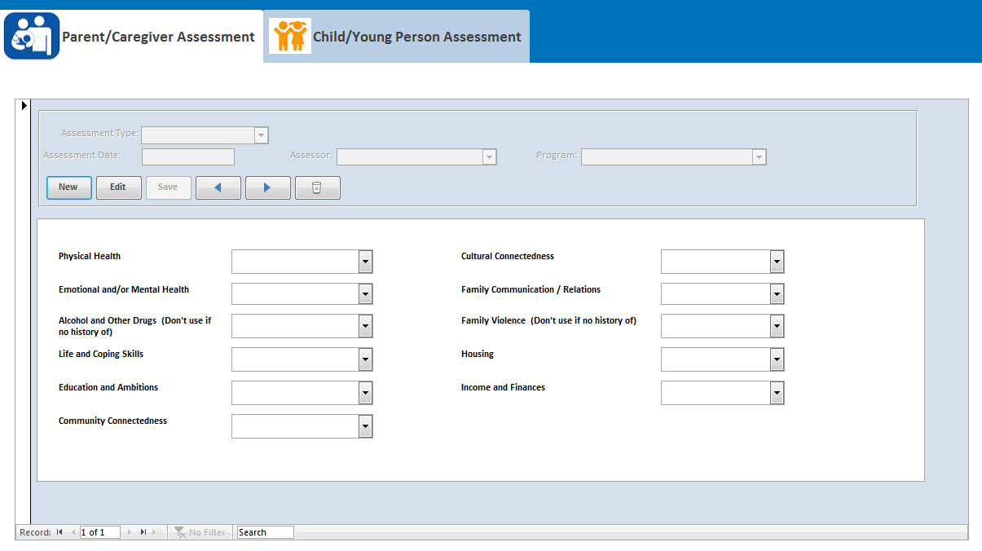
Example of COF System – Adding Parent Assessment

Slide 20
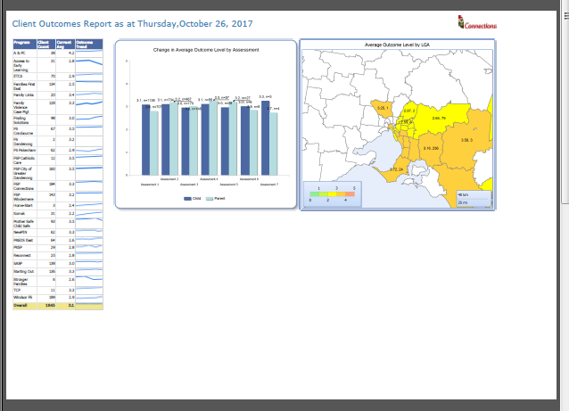
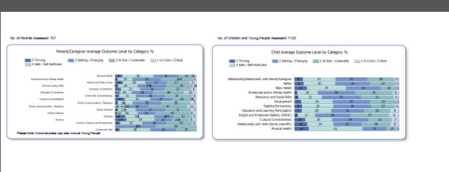
Example of Organisational Level – Summary Report

Slide 21
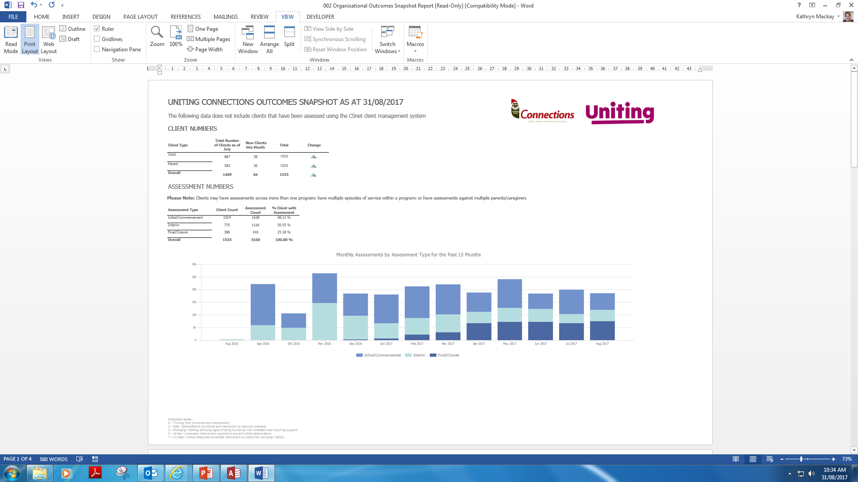
Example of Organisational Level Reporting – Snapshot Report Page 1 of 4 (client numbers)

Slide 22
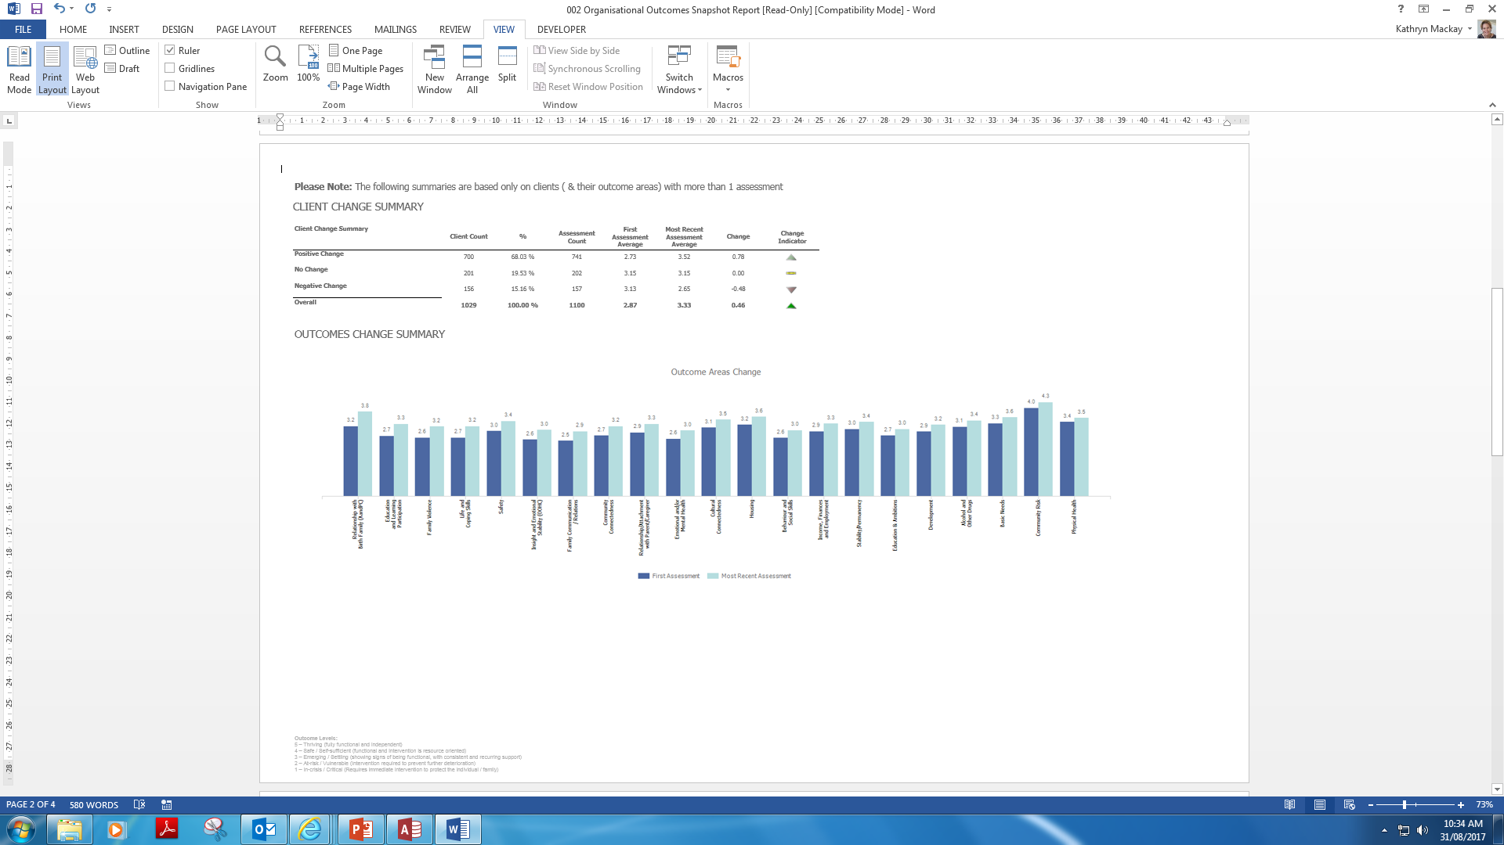
Example of Organisational Level Reporting – Page 2 of 4 (client & outcome area change)

Slide 23
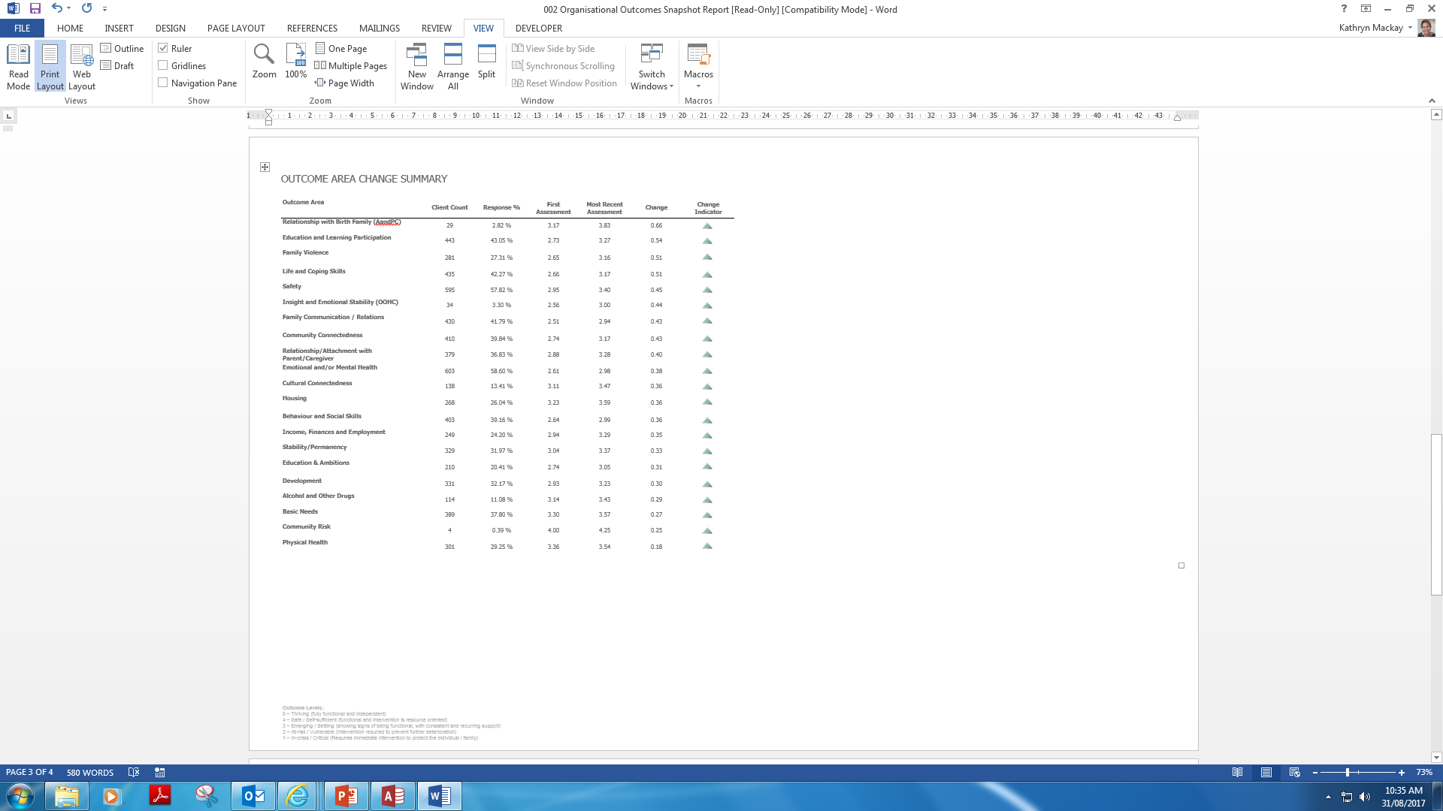
Example of Organisational Level Reporting – Page 3 of 4 (outcome area change summary)

Slide 24
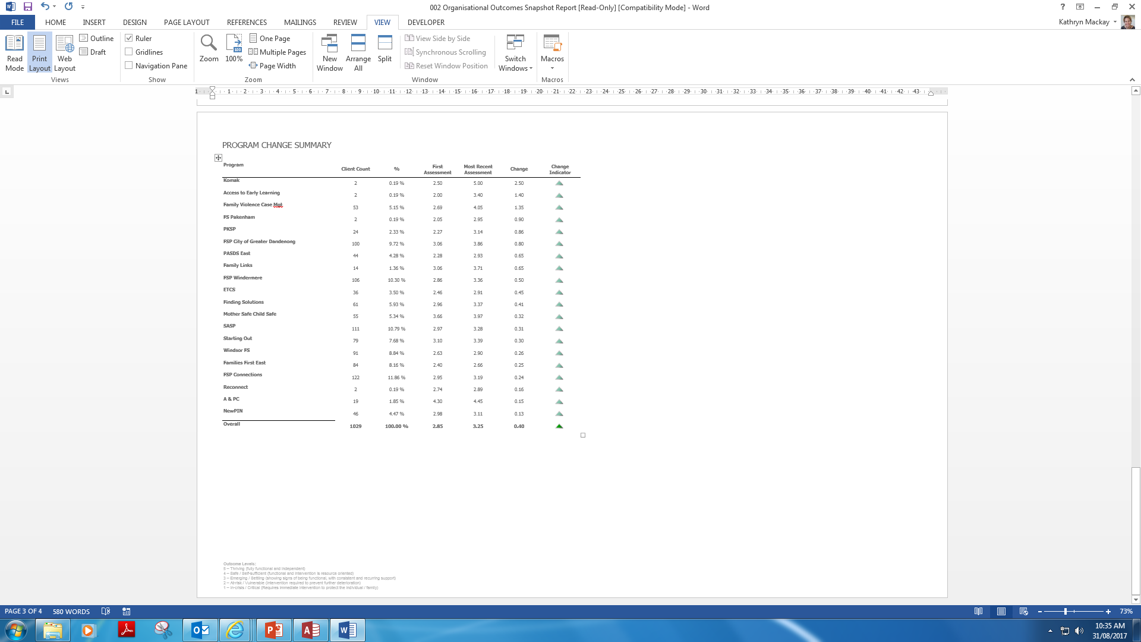
Example of Organisational Level Reporting – Page 4 of 4 (program change summary)

Slide 25
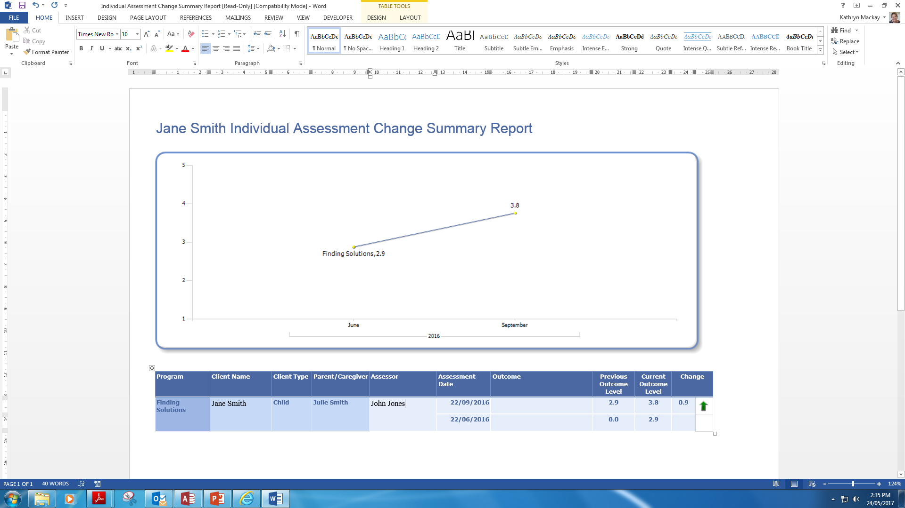
Example of General Client Report

Slide 26
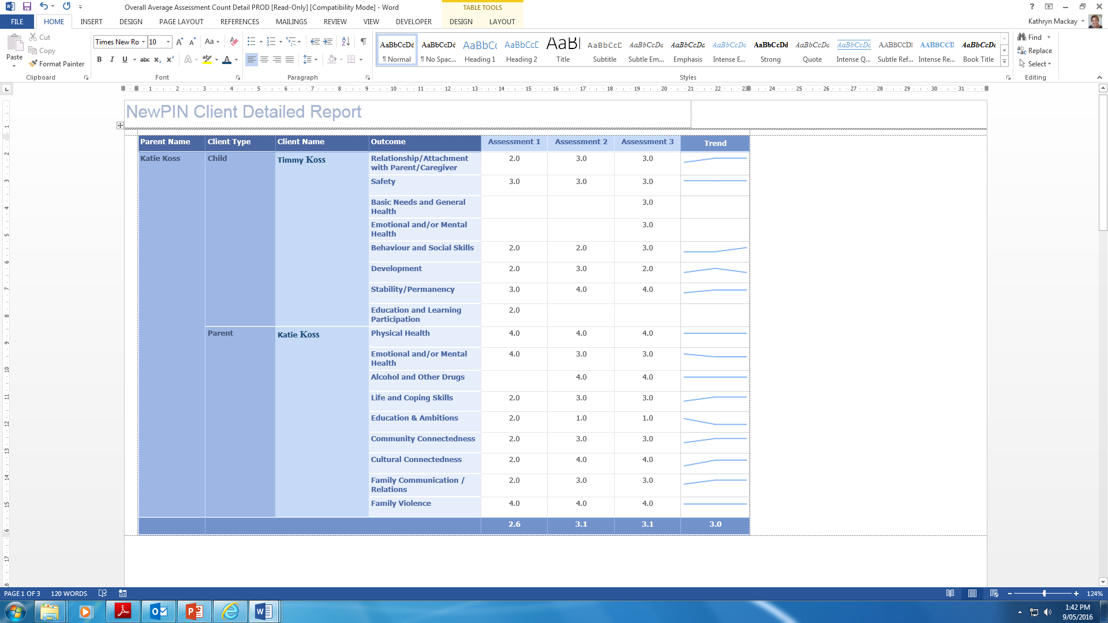
Example of detailed results by client (listing all outcome areas)

Slide 27
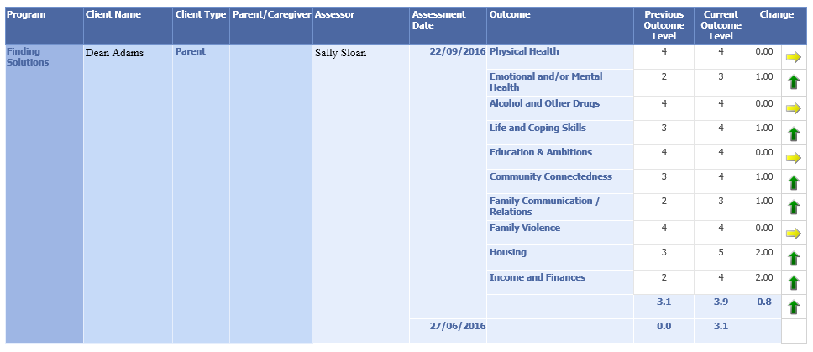
Further example of detailed client results – arrow as change indicator

Slide 28
The COF has also been built into the CSnet client management system, which is currently being trialled by our Eastern Family Services programs.
The system integrates outcomes measurement with goal setting and service delivery
The CSnet system has a reporting function and those programs therefore aren’t using the internally developed COF System.

Slide 29
Current High Level Change Data (from over 1200 clients with multiple assessments):
68% of clients with an increasing trend
18% of clients with a decreasing trend
14% of clients showing as stable
Outcome Areas demonstrating highest change:
Family Violence ↑14%
Life and Coping Skills ↑13%
Education and Learning Participation ↑13%
Child Safety ↑12.5%
Family Communication / Relations ↑11.5%
Community Connectedness ↑11%
Relationship/Attachment with Parent/Caregiver ↑10%

Slide 30
Implementation – What Helped:
Whilst there have been some hurdles along the way (which to some degree will continue into maintenance phase), a range of strategies were used to minimise and address these.

Slide 31
Development of an outcomes framework was included in the Strategic Plan, which set the scene for the project.
This was backed up through consistent messaging from the CEO, Community Services General Manager and Senior Management to maintain traction – e.g. at forums and meetings.
As a result there was high level of awareness amongst staff of the project and the rationale behind it.
High Level Endorsement -

Slide 32
Resources –
Connections recruited a Project Leader to develop and implement the COF and followed this up with the recruitment of a Systems Developer/Data Analyst to build and maintain the COF System.
These focused resources were instrumental in driving and maintaining the momentum of the project, and in achieving results within a relatively short timeframe.

Slide 33
Staged Implementation –
Stage one involved four smallish and relatively contained programs, which greatly assisted in the engagement and the development process.
HOWEVER – be sure to check in with the wider program group along the way to ensure what is being developed meets the needs of all programs. This is something we could have done more of and would have saved us time later on!

Slide 34
Staff Involvement –
Development of the COF outcome areas, indicators and measures, service delivery tools and workflows occurred in close consultation with the stage one programs
A number of drafts and adjustments were made following staff feedback and the transparency of this process helped achieve staff buy-in and a sense of ownership.
Because of the variances in program types, staff numbers and staff mix, the programs moved through the process at differing paces and it was important to accommodate this.

Slide 35
Communication –
Communication about the COF has been regular and in multiple formats, which helped keep the project visible across the wider staff group. Communication included:
Bi-monthly project updates sent to all staff – and then included in the news section of the Intranet
Presentations of the COF model to all sites
Project updates at management and leadership forums
Project updates to the Board, Strategic Leadership Team and Senior Management

Slide 36
Maintenance
Implementation is never done!
A range of strategies are being used to ensure outcomes measurement is embedded into standard practice:
COF ‘snapshot reports’ with a focus on outcome trends being provided on a regular basis to all programs (highlighting the difference being made)
All guidelines and resources available on the staff intranet
Ongoing training and support
Incorporating the COF into agency documents, tools and checklists, such as the program practice manuals, supervision template, client file checklist and client file audit tool

Slide 37
Additional Highlights
Receiving the Social Impact Measurement Network of Australia (SIMNA) award for ‘Best Newcomer to Social Impact Measurement’ (April 2016)
Use of the COF by external agencies as part of the Family Services Plus and Targeted Care Packages programs
COF data making up key evidence for the Parenting Research Centre assessments of our School Attendance Support and Mother Safe Child Safe programs
Sector interest in the COF, leading to involvement on the DHHS Outcomes Working Group and some consultancy opportunities

Slide 38
Questions?

