Slide 1
Murky Waters: issues of consent and decision-making for vulnerable young people
Dr Margaret Kertesz – University of Melbourne
Dr Trish McCluskey – Berry Street
Open Sector Research Symposium
30 October 2017
Notes:
Supporting vulnerable young people in making decisions
How do practitioners judge the level of independent decision-making to accord a vulnerable young person?
The story starts with a focus on records and identity for people growing up in OOHC
Life story archive - Identity Documents, Educational &Medical Records, Family History, Life story materials, History of Care
A multi-disciplinary pilot project, Working in the Cloud, followed our earlier Who Am I? research, in the context of national out-of-home care standard 10:
Children and young people in care are supported to develop their identity, safely and appropriately, through contact with their families, friends, culture, spiritual sources and communities and have their life history recorded as they grow up.
The Working in the Cloud research arose from our assessment that the only way to ensure that records remain accessible for children in care who move between organisations and placements may be through a stable, online repository, a “virtual locker”.

Slide 2
Working in the Cloud Research
Exploratory research to develop a ‘virtual locker’
Multi-disciplinary team
digital archiving, computer science, social work, ethics, Berry Street managers, practitioners, young residents
Conceptual discussions
Focus group consultations to develop template
Documentary analysis of legislative and regulatory framework
Notes:
The Working in the Cloud research
arose from our assessment that the only way to ensure that records remain accessible for children in care who move between organisations and placements may be through a stable, online repository, a “virtual locker”.
This repository was to include both digital content (photos, digitised documents, certificates, text and video) and records about the location of physical possessions. This would mean photos, life story books, certificates, family information, reports, could be always easily accessible for young people while they are in care and after they leave care .
Ie the Life Story Archive – everything belonging to the child –
Identity Documents
Medical Records
Educational records
Family History
Life story materials
History of Care
Working in the Cloud research was exploratory and conceptual

Slide 3
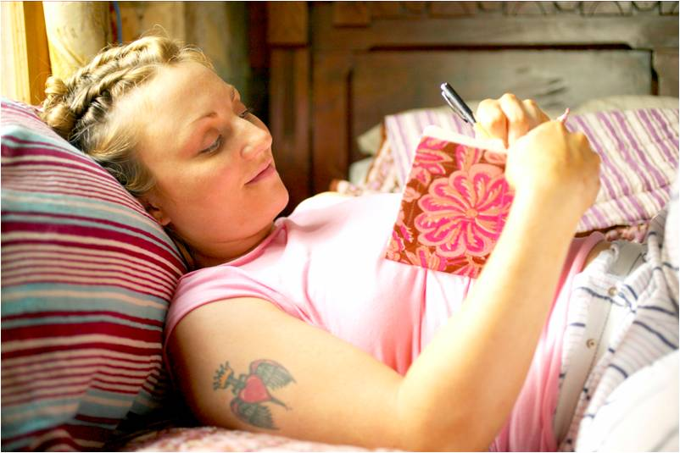
Notes:
How do practitioners judge the level of independent decision-making to accord a vulnerable young person?

Slide 4
How do practitioners judge the level of independent decision-making to accord a vulnerable young person?
What can the young person access?
What can be shared and with whom?
Workers, carers, friends, relatives
Can any of these people add material?
What should be private to the young person?
What can the young person destroy?
Notes:
Legislative and Regulatory Framework:
- If a digital repository were developed, a series of questions came up as how it would be managed.
Could the “virtual locker” have in-built, age-appropriate levels of decision-making authority, associated with what was stored, who had access, who owned these records and what would these protections be based on?
We sought to establish what guidance exists in Australian legislative and regulatory frameworks to answer these questions.

Slide 5
Documentary Analysis
Online search of: legislation, government fact sheets and websites, other websites summarizing or explaining legislation, issues papers and policy frameworks
criminal law
contract law
family law
child protection law
children’s rights
Privacy law and policy,
Regulations re access to health and personal information, and access to personal documents

Slide 6
Findings – age of decisional authority
10-14 years: Age of criminal responsibility
15 years : Medicare
16 years: Citizenship Certificate
18 years: Consent re sharing of information in Family Violence situations
No reference to under-18s
Freedom of Information
Child Protection Policies on information access
Notes:
Summary of Findings
The legislative and regulatory frameworks reviewed in this paper provide some limited guidance about the issues which confronted the research team. Age is set in relation to criminal responsibility and a range of undesirable activities. Young people under a specified age are not deemed responsible in relation to contracts or for obtaining identity documents, though birth certificates are now an exception in Victoria.
However, while older legislation, such as FOI, neglects any mention of young people under 18, a consensus is emerging that 14-16 is the age range when young people begin to take on decisional authority for health matters and personal information.

Slide 7
Notes:
It is not really cut and dried.
Vic : you have to be 16 to get your ears pierced, or 18 to get a tattoo (unless you have written permission from your parent)
In many Australian jurisdictions it is illegal to sell spray paint to those under 18
We need to look at the relevance of both age and maturity.

Slide 8
Findings – relevance of age and maturity
Mature minor test (legal frameworks)
Convention on the Rights of the Child (article 12)
A child who is capable of forming his or her own views has the right to express those views freely in all matters affecting the child, the views of the child being given due weight in accordance with the age and maturity of the child.
Child Protection legislation – children can express their views and wishes Consideration given to their: age, developmental stage, maturity, understanding, developmental capacity
Notes:
The guidance in some more recent regulatory frameworks is consistent with the increasing emphasis on children’s rights and agency in the context of parental guidance and individual assessment of young people’s capacity found in the theoretical literature.
However, “care” is often a contested concept. A focus on caring can be another form of “oppressive paternalism” where children are judged incompetent if their views differ from adult opinions (Cockburn 2005; 2013). Children’s right to participate in decision-making is different from their level of decisional competence, and the two concepts can be confused (Cashmore & Parkinson, 2008).
Terminology in CP legislation across Australia - age, stage of development, maturity, understanding, developmental capacity

Slide 9
Useful Concepts
Standards and policies are valuable as general guidelines only
Age and Maturity are important
The context of decision-making matters
Decision-making in the context of a trusting relationship with family, carer or worker
Notes:
Where does this get us? - The legislative and regulatory framework gives us some general guidance, but refers us back to individual assessment. And this is all we can expect of standards and policies – they cannot cover every permutation of human experience.
Age and maturity - impact of trauma
- research showing that the ability of adolescents to make rational decisions varies little from adult capacity. However, adolescents’ actual decision-making processes are not based on cognitive capacity alone. They are also determined by a range of other influences that are “reactive, intuitive, experiential, not necessarily conscious, and often based on social stereotypes or prototypes”
Context of decision-making – getting your ears pierced, making a decision about a medical treatment, sharing information about past experiences with a new worker or carer
Trusting relationships – someone you can talk through the issues with
being able to mistakes with someone there to support you
In the context of the corporate parent, issues of cyber-safety, data security and identity theft apply to policies of access and sharing. This is particularly important where successive professionals take up and leave the role of supporting young people to view or share personal information safely and appropriately
It involves not just the young person trusting the adult to know personal details about them, but also the adult being able to adapt their professional knowledge and judgement through listening to what each individual young person, knows, values and wants

Slide 10
Notes:
HANDOVER TO TRISH

Slide 11
Some current information/consent dilemmas
The context of children in OOHC: Who owns the record?
Why age does and doesn’t matter.
What might stop us handing over ownership of records?
Age?
Liability
Thinking and language
The lessons of history

Slide 13
Example of consent: (from FV Information sharing guidelines)
18 for consent to share information.
Case scenario: young 17 year old mother. Family violence issues. Records uploaded. Should consent be required to share information?

Slide 14
Issues
Everyone’s life story is different.
Hard and fast rules may not work.
Perhaps we can customise to reflect this uniqueness.
Who decides on maturity?
How do we determine maturity?

Slide 15
Skills needed
Ability to understand a young person’s present and future identity needs.
Willingness to support the young person in decision making and advocate when needed.
Act as a protective advisor about secure containment of records.
Knowledge of adolescent development and ability to see the young person’s point of view.
Relationship, relationship, relationship.

Slide 17
Thank You
QUESTIONS?
COMMENTS?

