Slide 1
Playing Around in Resi: Taking Good Care and Making it Great

Slide 2
Enhancing Good Care provided by Therapeutic Residential Care model through inclusion of:
Sensory Profiles;
Staff development;
Body based interventions; and
Establishment of regular play based therapies within the TRC house.

Slide 3
Conrad Street

Slide 4
The typical client in TRC at Westcare has a complex history of relational trauma and disruption and have presentations that reflect a life of inconsistent care, abuse, neglect and rejection.

Slide 5
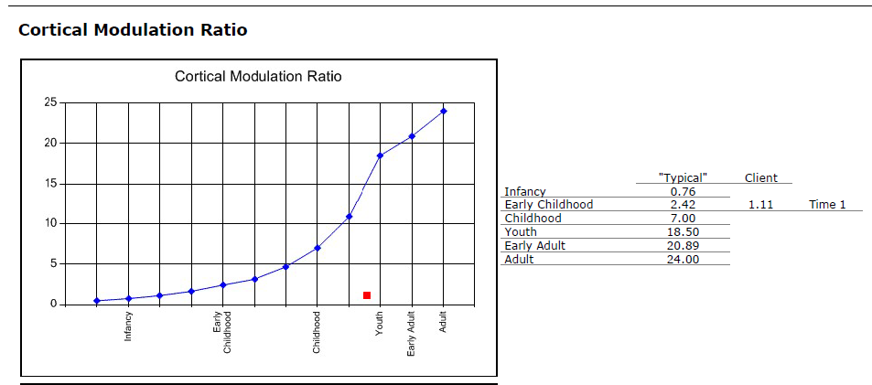
Priority for intervention is RELATIONAL,
BODY BASED & NON VERBAL

Slide 6
Young people need a sense of safety in order for any Therapeutic treatment to be effective. Not just safety of the physical environment, but a felt, physiological sense of safety.

Slide 7
REPAIR Model

Slide 8
Why Sensory Assessment?

Slide 9
Why Play?

Slide 10
TRC ‘Plus’
TRC | Plus
Clients Matched to Placement
Staff Training | + Staff Professional Development
Reflective Practice | + Staff participation in assessment and planning
Therapeutic Specialist | + Play Therapist
Take Two Assessment | + OT Sensory Profile Assessment
Therapeutic Plans | + Integrated Plan

Slide 11
Placement Transition Plan
Initial Therapeutic Plan
Integrated Therapeutic Plan with Specific Interventions
Take Two Assessment
Sensory Profile
NMT Tool
Ongoing Practice Development with Staff
Ongoing Review and Reflective Practice with Staff
Ongoing provision of Therapeutic Care interventions, both general to TRC House and Specific to Young Person

Slide 12
TRC UNIT STAFF
Additional Training Contributing to Assessment Developing Shared Language
Feedback & Recommendations
Intervention Planning
Integrated Therapeutic Plan
Feedback & Input from YP
Implementation
YOUNG PEOPLE
Complete Self Report Tools
Sensory Profiles to OT

Slide 14
Conrad St Unit Staff
Additional Training & Development
Drawing out expertise and specific knowledge of young person ; the Unit Staff often already know so much
Developed shared language for understanding needs of young person
Participate in assessment and development of Intervention Plans

Slide 15
Sensory Profile Assessment
Occupational Therapist with Take Two
Integrates knowledge from previous Take Two assessments
Sensory Profile 2: Carer Report & Young Person Self Report
Additional Questionnaire for Carers, Parents, Teachers
Additional tools regarding Triggers, Calming Strategies and Emotions completed by Young Person

Slide 16
Intervention Planning: Individual
SP Report Recommendations integrated with NMT Tool findings
Staff use SP Report recommendations & NMT Priorities to complete intervention plans for Young Person
Staff compile list of equipment, activities and resources needed to support Young Person
Staff identify what strategies can be used at different times of day and different spaces

Slide 17
TIME OF DAY | ENTRY HALL | KITCHEN/DINING | BEDROOM | LOUNGE | OUTSIDE | CAR/COMMUNITY
ALL TIMES | Container with mints/lollies, etc | Provide bright coloured plates, cups, etc. | Hooks for clothing Give important items a set place in the room |  |  | Textured seat belt covers
MORNING |  |  | Slightly Open Blinds Regular morning routine |  | Bounce/throw balls Trampoline Gardening
AFTERNOON |  | Make Smoothies Colouring In | Ensure room is tidy Bean bag | Happy Sack activity Fidget toys Bean bag to sit in Scents in diffuser Dancing | Sunglasses Hammock | Limit going to busy places 1:1 outings when possible
EVENING |  | Involve in cooking Add or remove flavour and texture |  | Weighted toys Weighted lap blanket Oil diffuser Rocking Chair White Noise
BEDTIME |  | Make a hot drink | Lamp/Fairy lights Sleep scent in diffuser Regular night routine | Lower lighting Soothing music Relaxing scents
OVERNIGHT |  |  | Weighted doona Soft toys White noise/fan

Slide 18
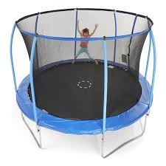
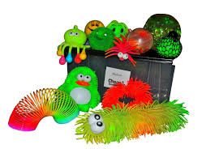
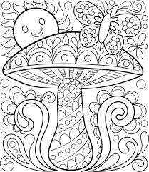
Interventions: Whole of House
Purchase of sensory toys and equipment for each room
Established weekly routines and rhythms
Inclusion of play, games, sensory based activities throughout the day
Staff feel confident to interact with young people and make assessments based on their arousal levels

Slide 19
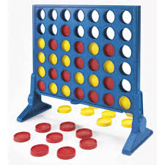
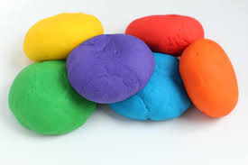
Interventions: Whole of House
Weekly Play Therapy Sessions
Both staff and young people to participate
Potential for individual work as indicated
Music & Art Sessions
Alternating on ‘Conrad Tuesdays’
Provided by Therapists experienced with client group
Equine Mentor Program

Slide 20
Our aim is to create a sensory rich Therapeutic Environment that has the same routines, rhythms and opportunities regardless of who is home and what staff are on.

Slide 21
 | Monday | Tuesday | Wednesday | Thursday | Friday | Saturday | Sunday
12am- 4am
2am – 4am
4am – 6am
6am – 8am
8am – 10am | Morning Routine | Morning Routine | Morning Routine | Morning Routine | Morning Routine | Morning Routine | Morning Routine
10am – 12pm | Education | Education | Education | Education | Education | Adventure /Outdoor Activity | Adventure /Outdoor Activity
12pm- 2pm |  |  |  |  |  | Adventure /Outdoor Activity | Adventure /Outdoor Activity
2pm – 4pm |  | Individual Play Therapy Session | Group Play Therapy Session |  | Equine Mentor Program
4pm – 6pm
6pm – 8pm |  |  |  | Music/Art Session
8pm – 10pm | Evening Routine | Evening Routine | Evening Routine | Evening Routine | Evening Routine | Evening Routine | Evening Routine
10pm – 12am | Sleep Needs Supported | Sleep Needs Supported | Sleep Needs Supported | Sleep Needs Supported | Sleep Needs Supported | Sleep Needs Supported | Sleep Needs Supported

Slide 22
Client Example

Slide 24
Imagine going into a dark room and trying to find your way around. The sensory profiles project is like a torch that gives us insight into smells, fabric, weight, light, colour that can help them and staff to be able to work with a better understanding.

Slide 25
Outcomes & Observations

Slide 26
Challenges & Opportunities

